Slide 1


Introduction to
Robotic Process Automation
Title of the Project
Your Register No.
Name
Guide Name
Designation and Department

Slide 2
Abstract
The "Entertainment Rating and Recommendation Bot" is a RPA solution developed using UiPath that enhances the movie selection experience. This bot provides users with comprehensive movie details, including ratings, reviews, release dates, budgets, and story summaries. It offers personalized movie recommendations, sends curated suggestions via email, and facilitates ticket booking for chosen movies. The system streamlines entertainment planning with convenience and efficiency, creating a seamless user experience.

Slide 3
Need for the Proposed System
The proposed solution addresses the challenge of finding accurate and comprehensive movie information from multiple sources, which can be time-consuming and inefficient. It simplifies the decision-making process by providing a centralized platform to access detailed movie insights, personalized recommendations, and ticket booking options. This automation saves time, enhances user convenience, and ensures an enjoyable entertainment planning experience.

Slide 4
Advantages of the Proposed System
Streamlines the movie selection and booking process for greater convenience.
.
Eliminates the need for manual searches by consolidating ratings, reviews, and other details in one place.
Provides personalized recommendations to help users discover movies that match their preferences.
Sends email updates to keep users informed about recommended movies.

Slide 5
Literature Survey
Automation in Entertainment: A Comprehensive Approach to Movie Recommendation and Ticket Booking Using RPA
ADVANTAGES
Automates movie details retrieval, saving user time and effort
Provides tailored recommendations, enhancing user satisfaction.
DISADVANTAGES
Relies on accurate external data, risking inconsistencies.
Raises data privacy concerns due to sensitive user information.

Slide 6
Literature Survey
Enhancing User Experience in Movie Selection and Booking through UiPath-Based Intelligent Bots
ADVANTAGES
High accuracy due to deep reinforcement learning.
Real-time adaptability to changing user preferences.
DISADVANTAGES
Data dependency: The model requires extensive, high-quality datasets
High reliance on computational resources for real-time processing

Slide 7
Main Objective
The main objective of the proposed solution is to streamline the movie selection process by automating the retrieval of movie details, including ratings, reviews, release dates, and budgets. By providing users with all relevant information in one place, it reduces the time and effort spent searching across multiple platforms.
Additionally, the solution offers personalized movie recommendations tailored to individual preferences, improving user satisfaction. It further enhances convenience by integrating ticket booking and email notifications, creating a seamless experience for users from selection to booking.

Slide 8
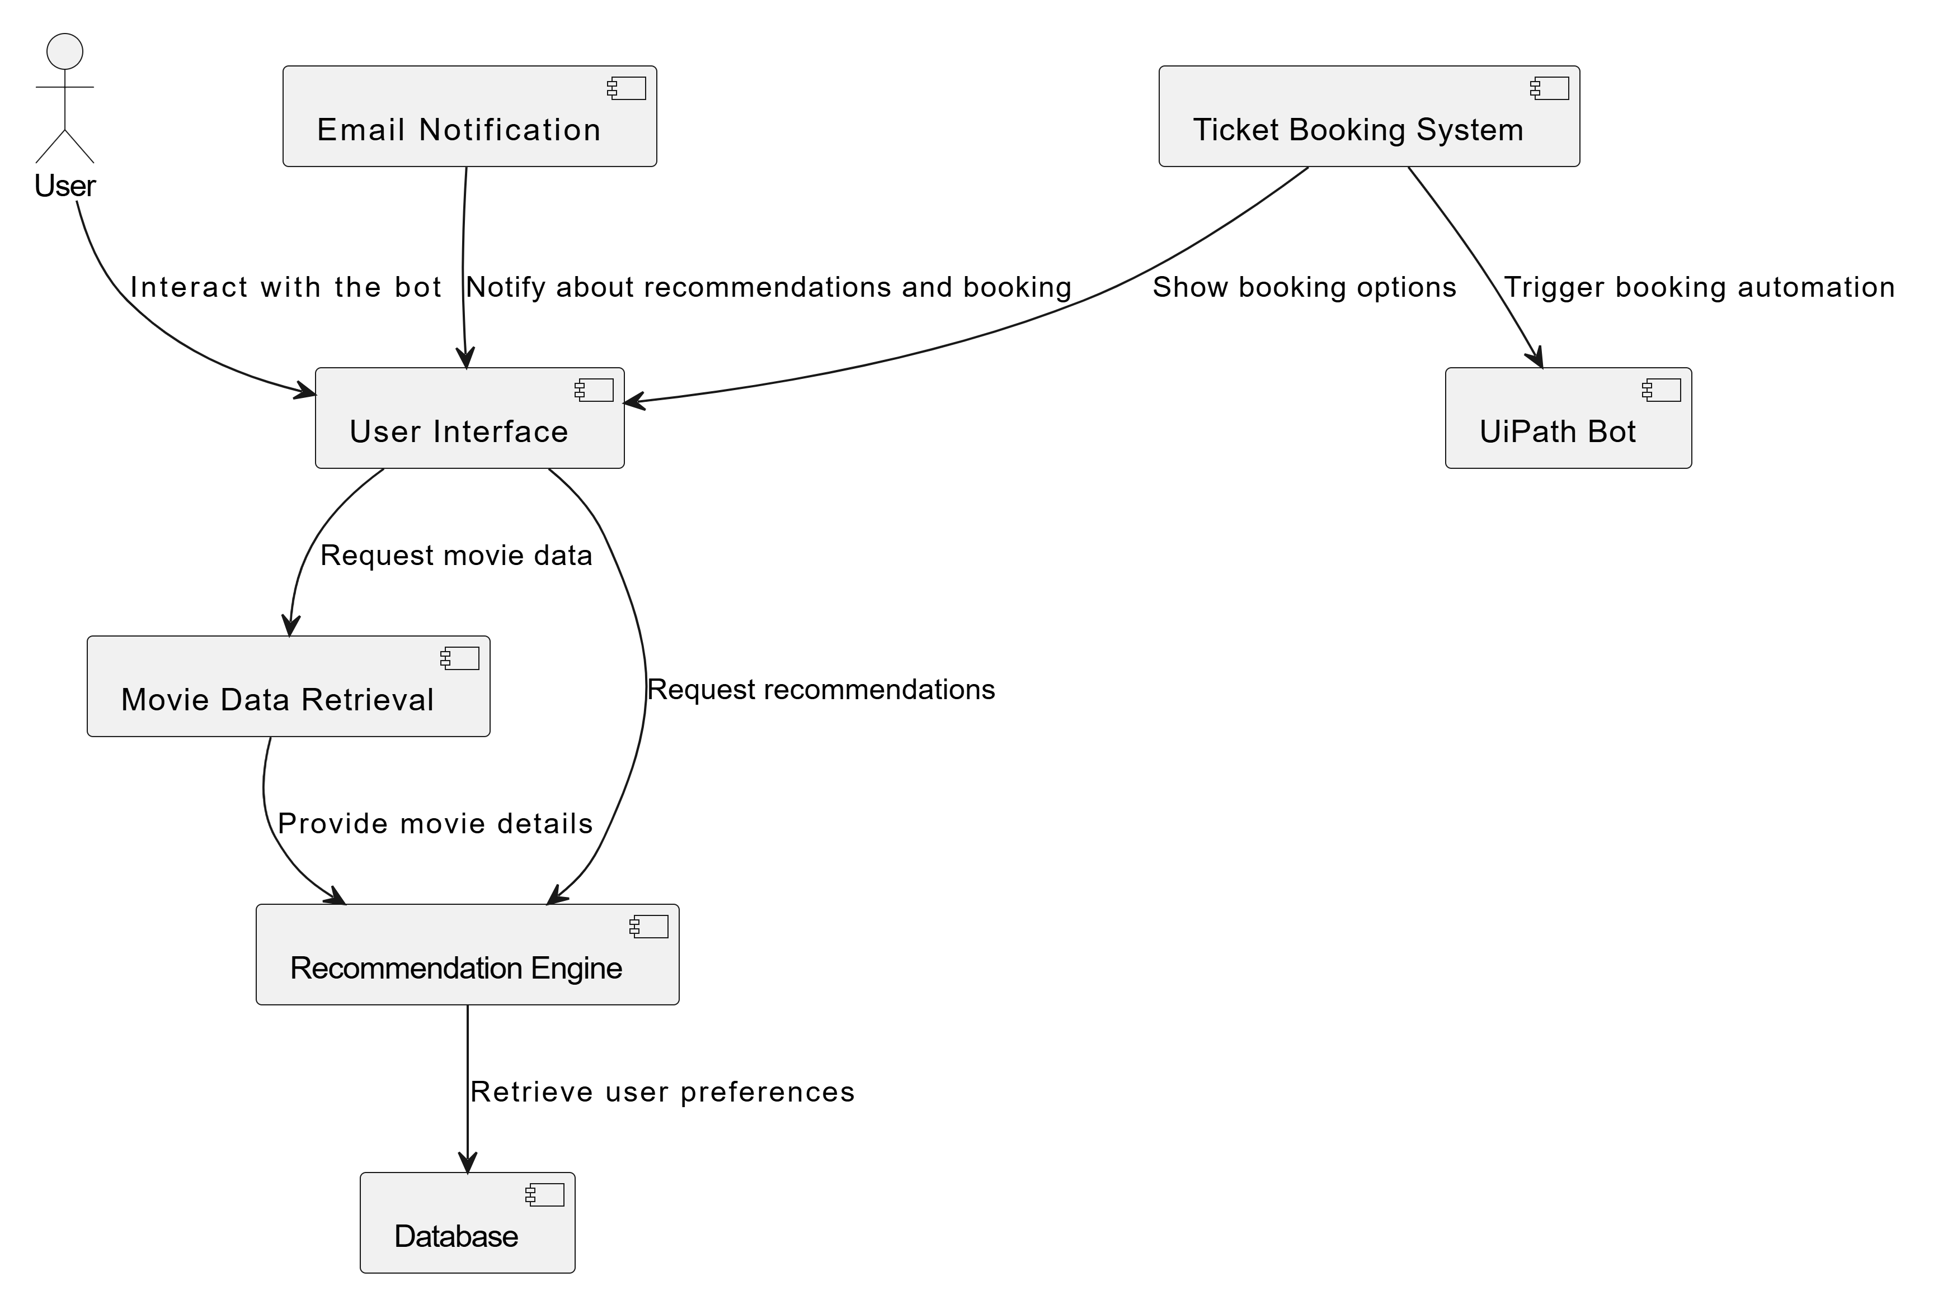
Architecture

Slide 9
System Requirements
HARDWARE REQUIREMENTS
UiPath Studio: Latest version
Operating System: Windows 10 (64-bit) or later
Microsoft Excel: 2016 or later
Email Service: SMTP (Gmail, Outlook)
SOFTWARE REQUIREMENTS
Web Browser: Chrome, Firefox, Edge
Processor: Intel i5 or higher
Storage: 10 GB free space
Network: Stable internet
Display: 1366x768 resolution

Slide 10
Functional Description
MODULE 1:INPUT HANDLING AND INITIALIZATION:
The system allows users to select a movie by name or ID, retrieving corresponding movie details from an external source. It automatically fetches key information such as ratings, cast, cost, story description, and release date from a movie database (e.g., IMDb or TMDB). Additionally, the system generates a dynamic email containing the fetched movie details and stores it for future reference.

Slide 11
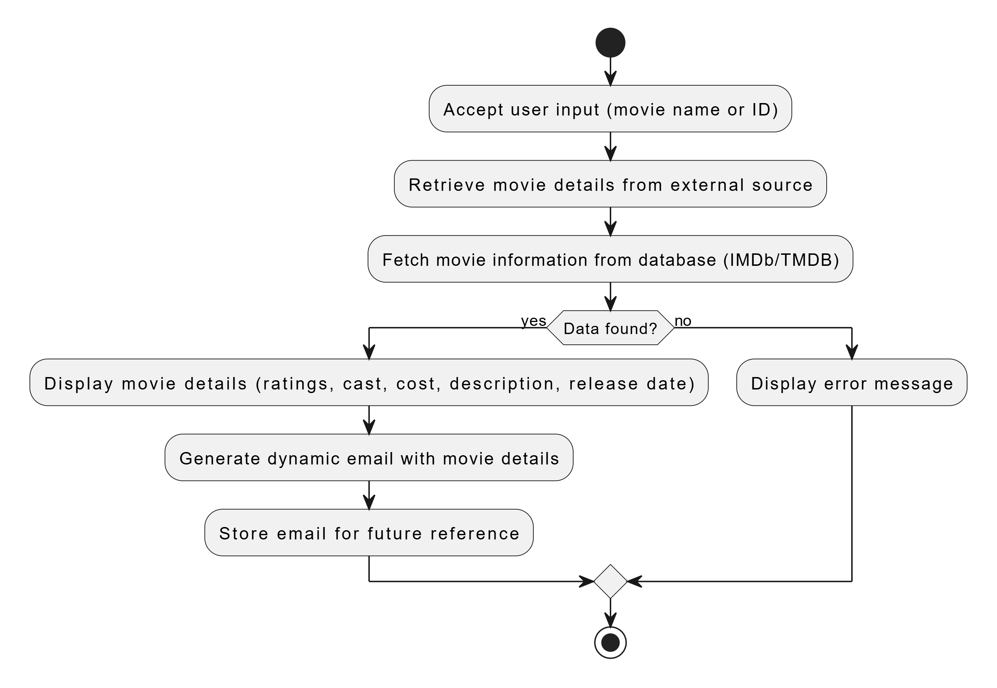
ACTIVITY DIAGRAM

Slide 12
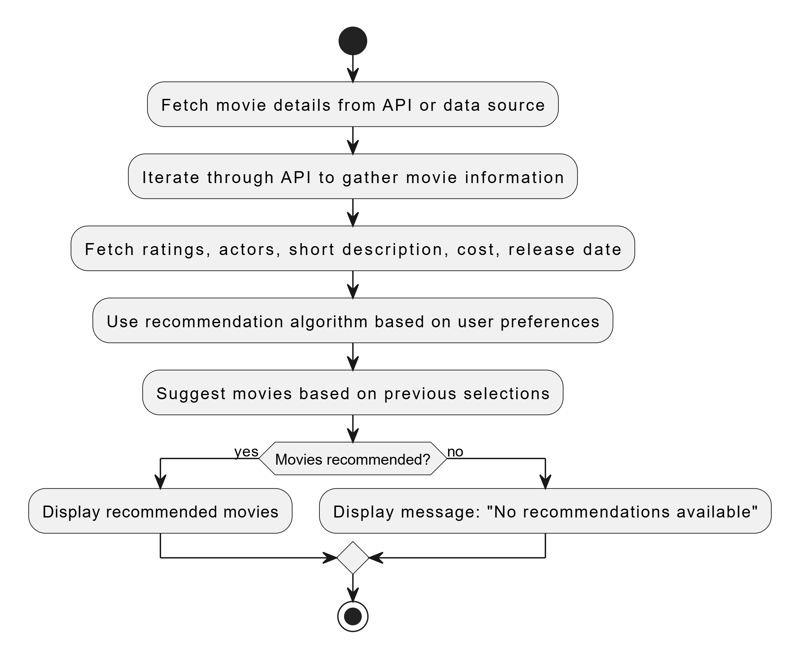
MODULE 2: CONTENT ANALYSIS
The system fetches detailed movie content by iterating through the movie's API or data source, gathering information such as ratings, actors, short description, cost, and release date. Additionally, it uses a recommendation algorithm to suggest movies based on the user's preferences or previous selections, enhancing the user's movie selection experience.

Slide 13
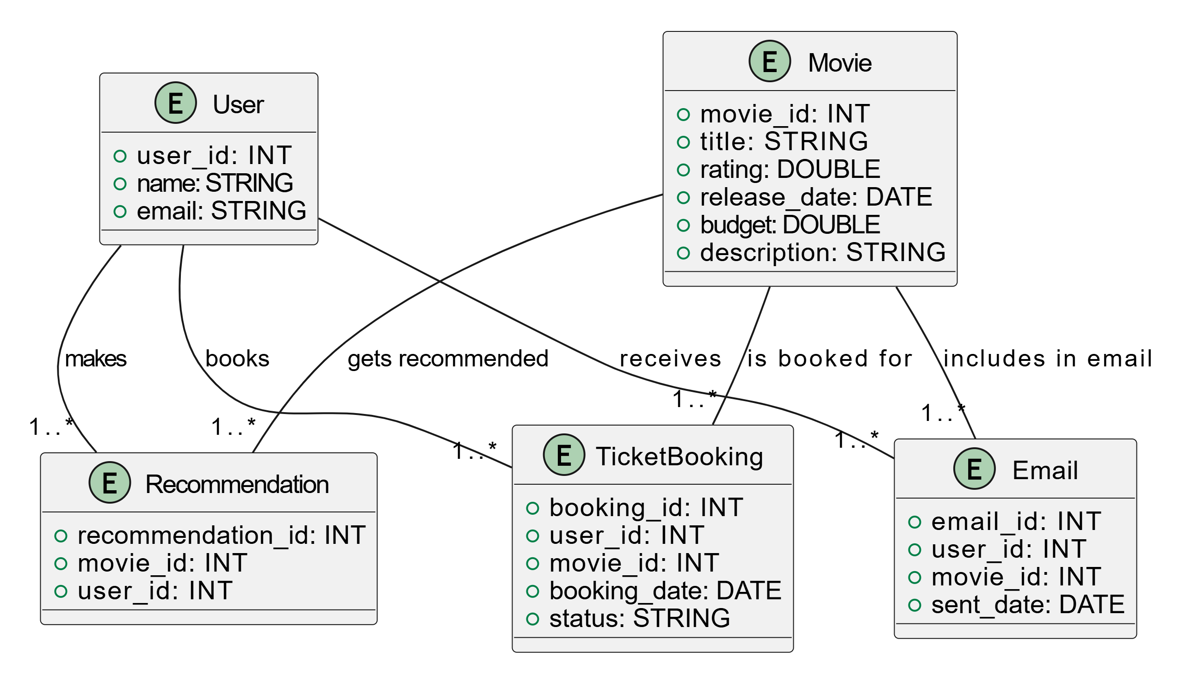
ENTITY RELATIONSHIP DIAGRAM

Slide 14
Process Design
MAIN PROCESS
The Entertainment Rating and Recommendation Bot automates the movie selection process by accepting user input to search for a movie by name or ID. It retrieves detailed movie data, such as ratings, reviews, release date, and budget, from external databases like IMDb or TMDB. The system then uses a recommendation algorithm to suggest similar movies based on user preferences. When a movie is selected, the bot generates and sends an email with movie details to the user and offers an option to book tickets. The entire process runs automatically, providing users with recommendations, reviews, and booking options without manual intervention.

Slide 15
SUB PROCESS
Movie Selection: Accepts user input to search for a movie by name or ID and validates the input data.
Movie Data Fetching: Fetches detailed information about the selected movie, such as ratings, reviews, release date, budget, and a short description from an external movie database (IMDb, TMDB).
Movie Recommendation: Uses a recommendation algorithm to suggest movies based on the user’s preferences or previous selections, ensuring relevant recommendations are provided.
Email Generation: Dynamically generates an email containing the selected movie’s details and sends it to the user for future reference.
Ticket Booking: Assists the user in booking tickets for the selected movie, providing a seamless and automated reservation process.
Recheck and Updates: Periodically checks the status of recommendations, updates the movie database for new releases, and sends updated recommendations as necessary.

Slide 16
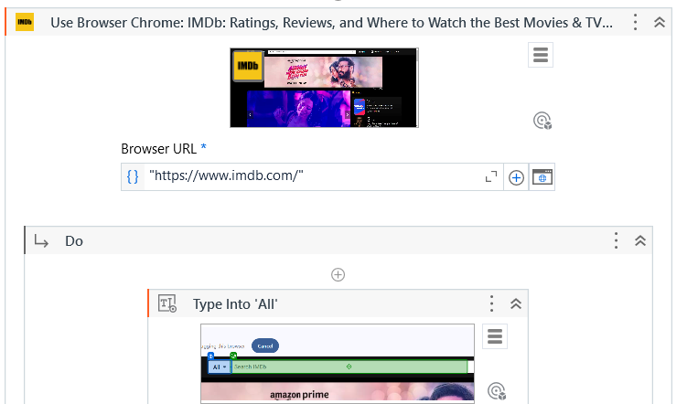
Implementation
MODULE 1:
The system allows users to select a movie by name or ID, retrieving corresponding movie details from an external source

Slide 17
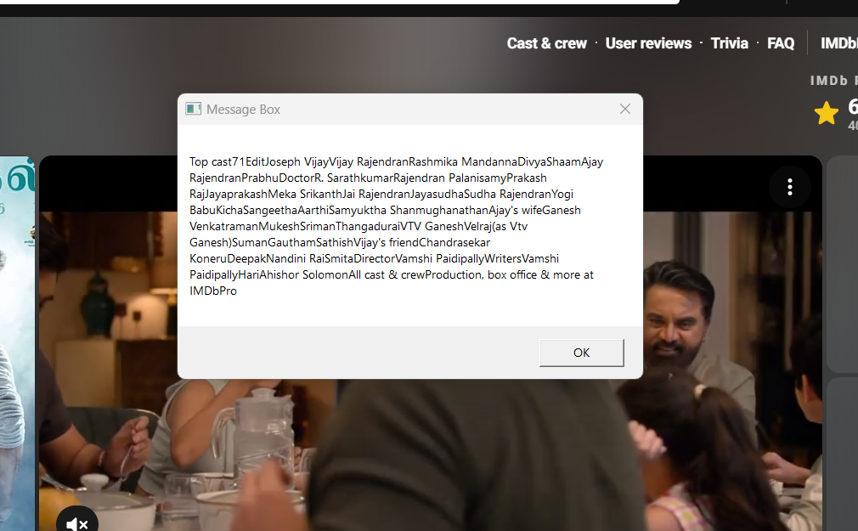
MODULE 2:
The system fetches detailed movie content by iterating through the movie's API or data source, gathering information such as ratings, actors, short description, cost, and release date

Slide 18
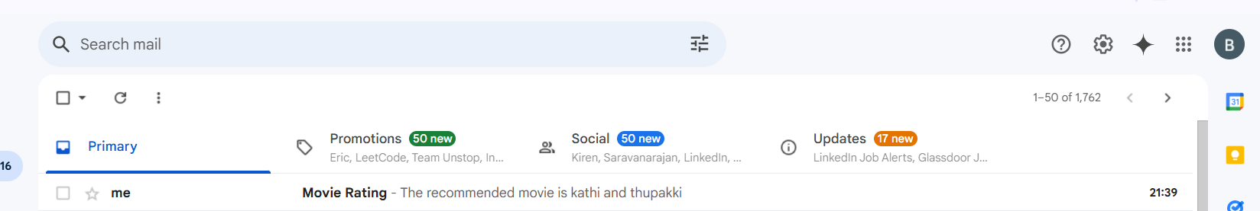
Testing
The bot will send the recommended movies via email to the registered mail account

Slide 19
Conclusions
The Entertainment Rating and Recommendation Bot offers a seamless and automated movie discovery experience by fetching detailed movie information, providing personalized recommendations, and assisting with ticket bookings. It enhances user convenience by continuously updating movie data and offering real-time recommendations, ensuring an efficient and engaging movie selection process.

Slide 20
Future Enhancement
Real-time Ticket Availability: Integrate real-time ticket availability from various theaters for seamless booking.
Social Sharing: Enable users to share movie recommendations and reviews on social media platforms.

Slide 21
IEEE Paper
"Content-Based Movie Recommendation System Using Machine Learning Algorithm" Authors: IEEE Xplore - Link​
"Research and Implementation of Movie Recommendation System Based on Deep Learning" Authors: IEEE Xplore – Link
"A Hybrid Movie Recommendation System Based on User Preferences and Collaborative Filtering" Authors: IEEE Xplore - Link

Slide 22
References
"Content-Based Movie Recommendation System Using Machine Learning Algorithm“
Read more on IEEE
"A Hybrid Movie Recommendation System Based on User Preferences and Collaborative Filtering"
Read more on IEEE​I
​

Slide 23
Queries

Slide 24
Demonstration

Slide 25
Thank You

